Slide 1
OpenAI API Features
Explore all of the core features that OpenAI offers

Slide 2
Overview of OpenAI Platform
Developer Platform: Comprehensive suite of AI models and tools.
Use Cases: From simple text generation to complex reasoning and multimodal applications.
Integration Options: SDKs available for Python, Node.js, and other languages.
API-First Design: Build AI capabilities directly into your applications.

Slide 3
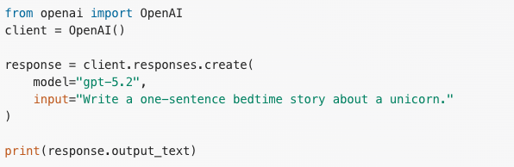
Core Language Capabilities
Text Generation & Completion
Models range from lightweight to advanced reasoning models.
Control parameters: temperature, max tokens, top_p.
Content filtering and safety measures built-in.

Slide 4
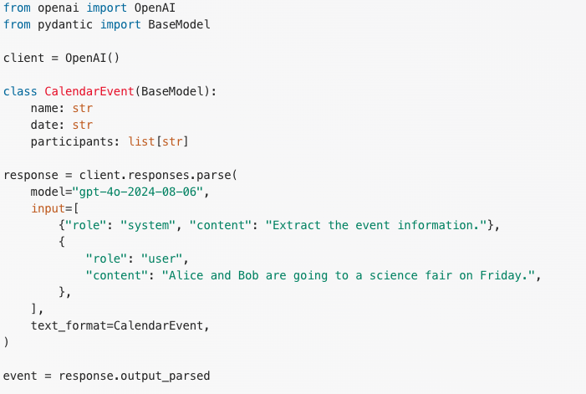
Structured Outputs
Getting Predictable JSON Responses
Perfect for data extraction and structured information retrieval.
Enforces output format validation.
Reduces post-processing effort.

Slide 5
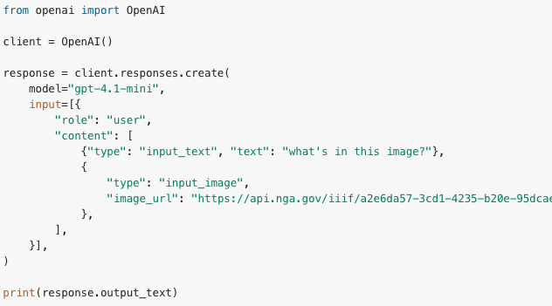
Multimodal Capabilities
Vision & Image Analysis

Slide 6
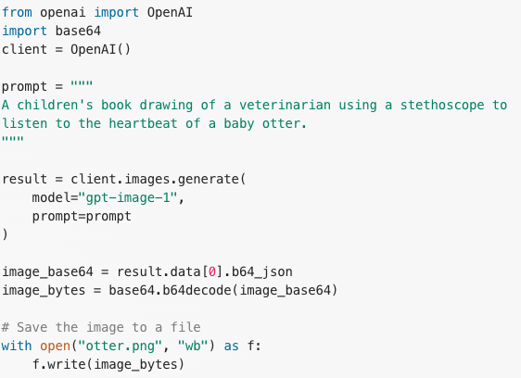
Multimodal Capabilities
Image Generation with GPT Image

Slide 7
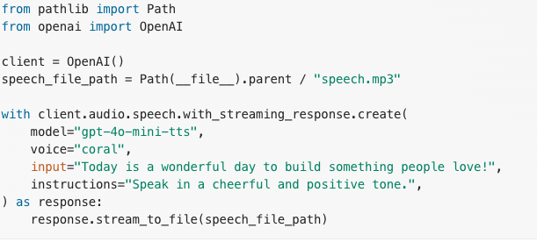
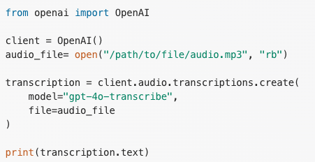
Audio & Speech Capabilities
Text-to-Speech
Speech-to-Text (Transcription)

Slide 8
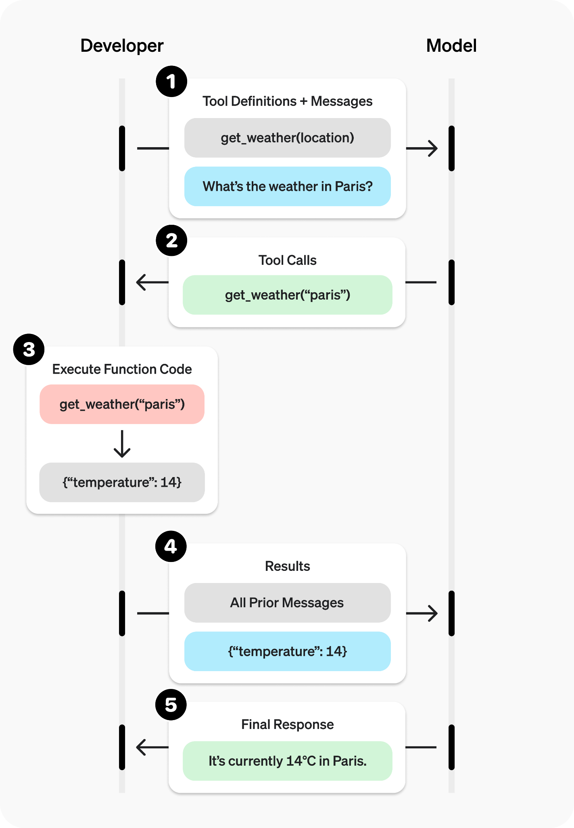
Advanced Features - Function Calling & Tools
Models can determine when to call functions.
Enables connection to external APIs and databases.
Build complex workflows and agents.

Slide 9
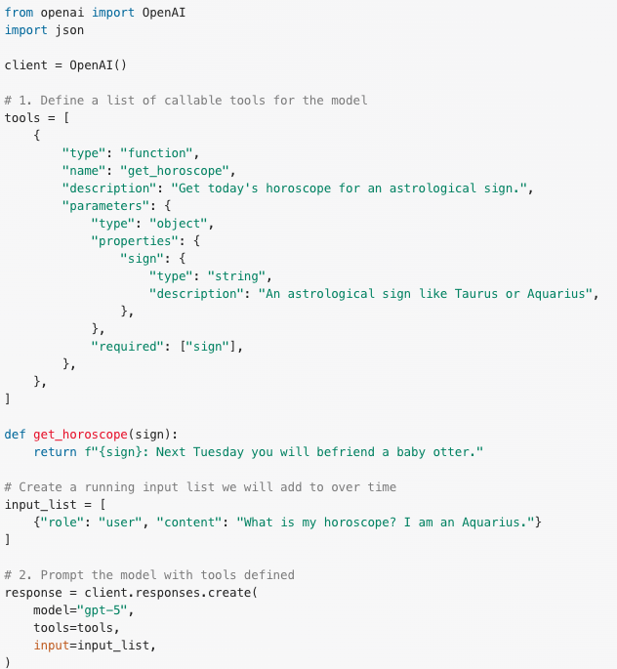
Advanced Features - Function Calling & Tools

Slide 10
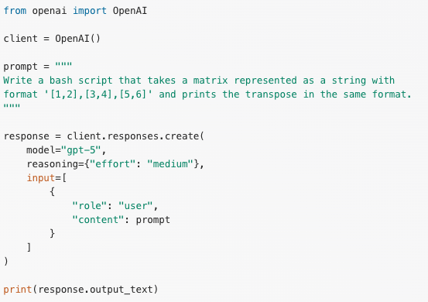
Reasoning Models
Complex Problem-Solving with Reasoning Models
Tackle complex tasks requiring multi-step reasoning.
Suitable for technical problem-solving and analysis.

Slide 11
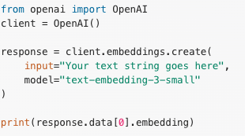
Embeddings
Vector Representations for Semantic Search and Similarity
Convert text into numerical vector representations
Enable semantic search and content recommendation
Applications:
Similarity matching
Content retrieval
Clustering and classification
Knowledge bases and RAG (Retrieval Augmented Generation)

Slide 12
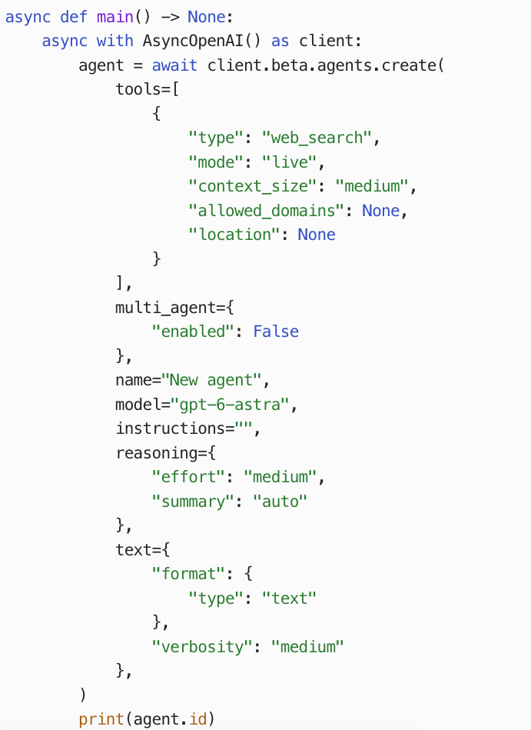
Managed Agents - Harness as a Service
Agents API - Easily create agents in cloud/local environments
Benefits:
Reduced boilerplate code, let OpenAI focus on the harness code whilst you focus on business logic.
Durable agents that can recover from failure.
Programmatically create, edit, update or delete agents without custom infrastructure.

Slide 13
Computer Use, Now Through the API
The same idea we saw earlier: an AI operates a visual interface.
A practical example
The application runs the loop
Test a signup flow in an
isolated browser and report
where the user gets stuck.
1 Send a screenshot
2 Model chooses the next action
3 Your app clicks or types
4 Send the new screen; repeat
You supply the browser or desktop environment.
Computer Use guide
Notes:
Connect this to the Computer Use lesson earlier in the course. The API gives our application the same ability to work through a visual interface. A useful example is testing a signup page: the agent looks at the screen, decides what to do, and checks the result after acting. With the Responses API, you provide and operate the environment; enabling a tool does not create a hosted desktop. The current docs recommend a code-execution integration for GPT-6 Astra, and also support the native computer tool with structured actions. Both approaches return observations to the model. The notebook uses the native computer tool to make the screenshot/action loop easy to see. Run only inside an isolated test environment, restrict the reachable destinations, and get human approval for consequential actions. This slide describes a capability; no real UI actions were performed while making the deck.
Source: https://developers.openai.com/api/docs/guides/tools-computer-use

Slide 14

Code Interpreter: Python in a Sandbox
The model writes, runs and refines Python code for your task.
OpenAI runs the code
Responses API tool configuration
tools=[{
"type": "code_interpreter",
"container": {
"type": "auto"
}
}]
Analyse files and calculate.
Create charts and new files.
Download the results.
Try: “Use Python to analyse this CSV and create a chart.”
Notes:
This is the most useful distinction for beginners: we do not have to write every line of the analysis ourselves. Give the model a file and a task, and Code Interpreter lets it write and run Python in an OpenAI-hosted sandbox. The result can include calculations, charts, a cleaned dataset, or another downloadable file. If a code step fails, the model can revise it and rerun. The configuration shown is the tools argument for a Responses API call with a supported model. Uploaded files must be attached or passed through the container's file_ids; the quoted CSV task is an illustrative prompt, not an executed result. In the companion notebook we upload a small sales CSV, request totals and a chart, check the calculation, and download the generated files. Files live in an ephemeral container, so save the outputs you need before it expires. Tool/container usage has separate API charges. Code Interpreter runs Python; programmatic tool calling on the next slides uses JavaScript to coordinate tools.
Source: https://developers.openai.com/api/docs/guides/tools-code-interpreter
Python logo source: https://www.python.org/community/logos/

Slide 15
Shell Commands + File Edits
Tools let agents work on real files and verify their changes.
Shell
Apply Patch
Run terminal commands.
Process files, run scripts
and check code with tests.
Create, update or delete files
using structured patches.
Your app applies the edits.
Shell: use an OpenAI-hosted container or your own runtime.
Shell guide
File edits: Apply Patch
Notes:
Code Interpreter is focused on Python. Shell gives an agent a terminal for broader work: run commands, inspect files, execute scripts and run tests. OpenAI supports a hosted shell container as well as a local runtime that your application operates. Apply Patch is the file-editing interface: the model requests create, update or delete operations as structured diffs, and your application or harness applies them and returns the outcome. A practical workflow is to edit a script, run its tests, inspect failures and revise the patch. The two tools complement each other, but enabling them is not a claim that every edit or command will succeed. Check the actual results and keep the permissions appropriate for the task.
Sources: https://developers.openai.com/api/docs/guides/tools-shell and https://developers.openai.com/api/docs/guides/tools-apply-patch

Slide 16
Making Tool Use More Efficient
Choose the mechanism that fits the work.
Tool Search
Load deferred tool definitions only when needed.
Useful when an agent has a large tool library.
Programmatic Calling
Use JavaScript to coordinate calls and filter results.
Useful for loops, batching and combining outputs.
Async Calling
Continue independent work while your app runs a slow tool.
Async uses direct calls, separate from programmatic calling.
Tool Search
Programmatic Calling
Async Calling
Notes:
These are three distinct mechanisms. Tool Search reduces the need to include every full tool definition at the start: tools can be deferred and loaded when relevant. It searches the tools made available to the application, rather than discovering arbitrary services. Programmatic tool calling lets the model write JavaScript in an isolated hosted V8 runtime to coordinate enabled tools, loop over calls, filter large results and return a compact answer. This JavaScript runtime is different from Code Interpreter's Python sandbox and has no direct Node, filesystem or network access. Access goes through eligible enabled tools. Client-owned tools still run in your application. Tool Search happens at the top level before a program can invoke a newly loaded tool. Async tool calling is another option: the model can continue independent work while your application runs a slow function or custom tool, then you deliver its result later using the call ID. It is not a hosted job runner and is separate from background response generation. Current docs do not allow async calling to be configured together with programmatic calling; async is for direct function/custom calls, not built-in hosted tools. Check supported models and tool types before enabling either option.
Sources: https://developers.openai.com/api/docs/guides/tools-tool-search, https://developers.openai.com/api/docs/guides/tools-programmatic-tool-calling, https://developers.openai.com/api/docs/guides/async-tool-calling

Slide 17
Customization Options
Fine-tuning
Train models on your specific data.
Improve performance on domain-specific tasks.
Reduce prompt engineering requirements.
Evals
Systematically evaluate model performance.
Create benchmarks for your specific use cases.
Identify areas for improvement.
Distillation
Create smaller, specialized models.
Reduce inference costs and latency.

Slide 18
Developer Resources
Documentation: Comprehensive guides and API references
Cookbook: Open-source code examples and tutorials
Developer Forum: Community support and discussions
SDKs: Official libraries for multiple programming languages
Rate Limits & Quotas: Understand usage limitations

Slide 19
Getting Started
Create Account: Sign up at platform.openai.com.
Generate API Key: Secure authentication for API requests.
Choose a Model: Select based on your use case and budget.
Install SDK: pip install openai or use another language SDK.
Make Your First Call: Follow quickstart guide documentation.
Scale Gradually: Monitor usage and optimize as you grow.

